Slide 1
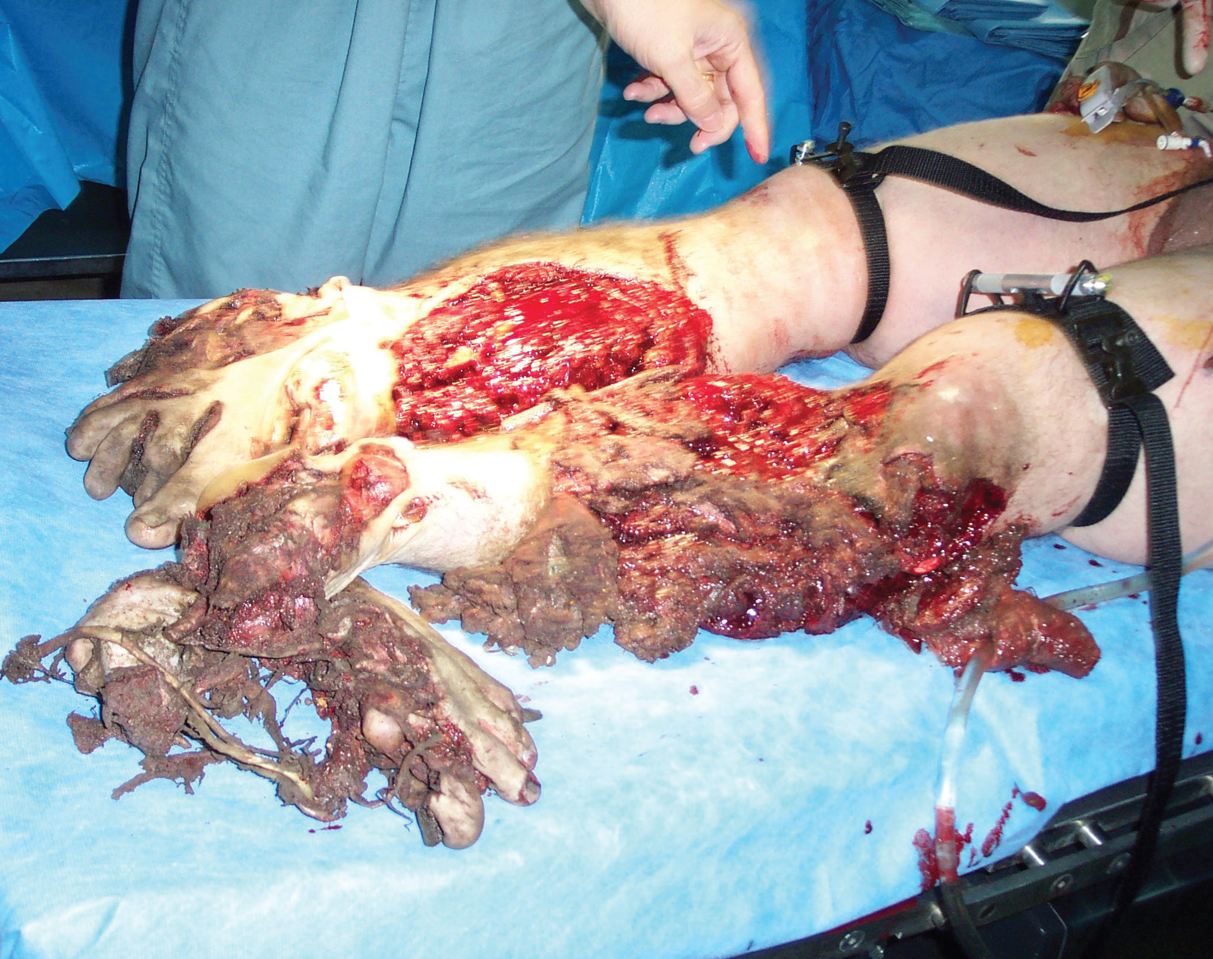
LESSON 4 CONTROLLING BLEEDING

Slide 2
CONTROLLING BLEEDING
TASK
Apply an Emergency Bandage, Combat Gauze, manual pressure dressing, Combat Application Tourniquet, and/or improvised tourniquet, as needed.
CONDITIONS
Given a simulated casualty with bleeding from a limb and needed supplies.
STANDARDS
Score a GO on the performance checklists.
Additional injuries to the casualty are prevented.
REFERENCES
STP 21-1-1-SMCT, Soldier’s Manual of Common Task:
Skill Level 1. FM 4-25.11, First Aid

Slide 3
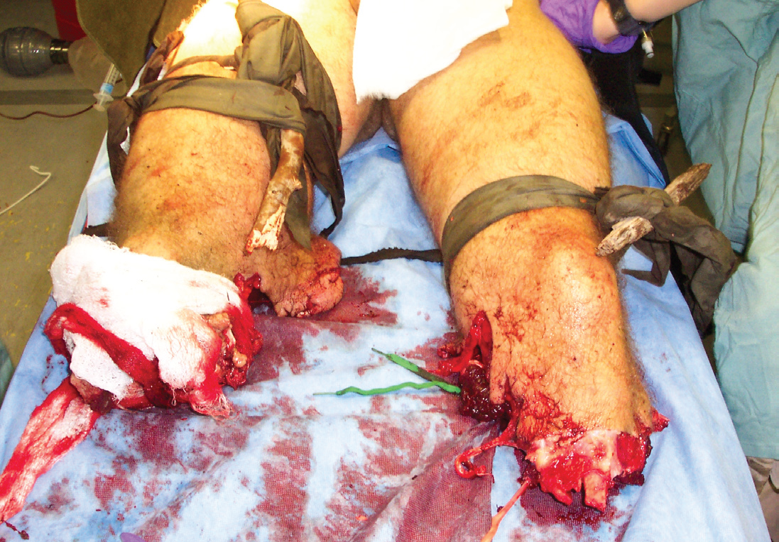
CONTROLLING BLEEDING
Failure to control bleeding is the major cause of death
among casualties who could be SAVED!!!

Slide 4
CONTROLLING BLEEDING
All amputations require a tourniquet!
Remember:
If while under enemy fire a tourniquet is used to control bleeding, reevaluate tourniquet in Phase 2 of TC3.

Slide 5
CONTROLLING BLEEDING Expose the wound Phase 2
To view the extent of the injury, if possible, push or cut away loose clothing.
“If you can’t see it, you can’t treat it.”
Warning:
Do not remove protective clothing in a chemical environment.
Caution:
Clothing or anything else stuck to the wound should be left alone to avoid further injury.

Slide 6
CONTROLLING BLEEDING Emergency Trauma Bandage
Remove the bandage from the packaging
Place pad directly on the wound
Wrap the elastic portion of the bandage around the wound.
Insert the elastic bandage completely into the pressure bar.
Pull the elastic bandage back over the top of the pressure bar.
Wrap the elastic bandage tightly over the pressure bar.
Continue to wrap the elastic portion of the bandage around the limb so that all the edges of the pad are covered.
Secure the hooking end of the closure bar into the elastic bandage.

Slide 7

Emergency Trauma Bandage

Slide 8
CONTROLLING BLEEDING Combat Gauze
Is impregnated with a hemostatic agent that will cause the blood to clot.
Used places where a tourniquet cannot be utilized.
Neck
Armpit
Groin

Slide 9

CONTROLLING BLEEDING Combat Gauze

Slide 10
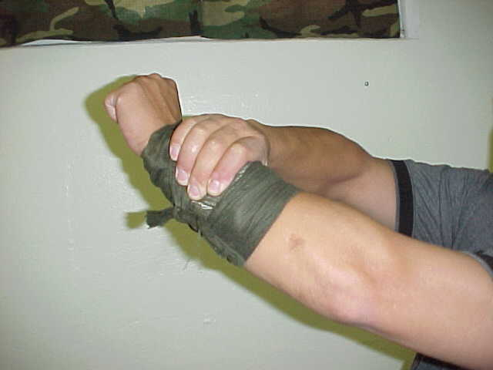
CONTROLLING BLEEDING
Apply direct pressure and elevate for 5 to 10 minutes
If a fracture is suspected
DO NOT!!!
elevate the injured limb until
it has been splinted

Slide 11
CONTROLLING BLEEDING
If bleeding continues…
For an ETB, tighten bandage to form a pressure dressing
For an improvised dressing, apply a pressure dressing

Slide 12
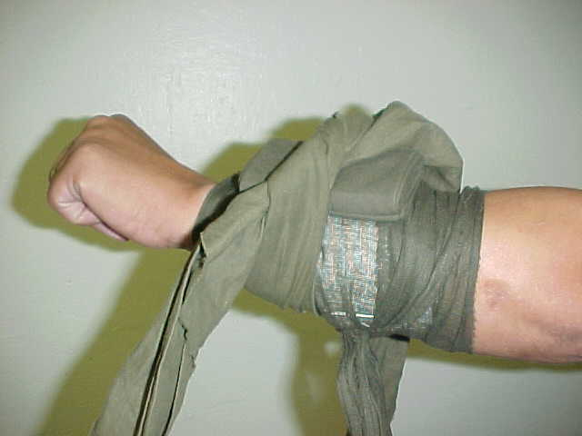
CONTROLLING BLEEDING
APPLYING A PRESSURE DRESSING
Place a cravat over the wad of padding and wrap around the limb.

Slide 13
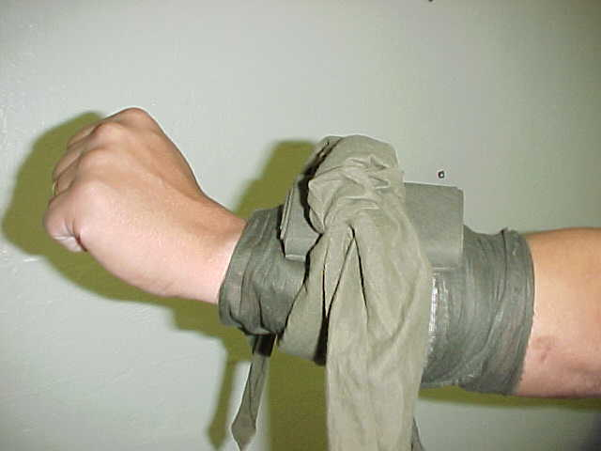
CONTROLLING BLEEDING
APPLYING A PRESSURE DRESSING
Tie cravat ends into a non-slip knot directly over the wound
Check circulation below the wound site and apply manual pressure

Slide 14
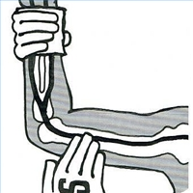
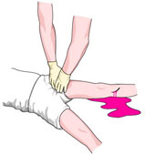
CONTROLLING BLEEDING Applying digital pressure
Applying digital pressure to the brachial artery (Arm/Upper extremity)
Applying digital pressure to the femoral artery
(Leg/Lower extremity)

Slide 15
CONTROLLING BLEEDING Applying a Tourniquet
Determining if a tourniquet is required:
Wound of an extremity
Arterial bleeding of thigh/lower leg, arm or
multiple arteries
Amputations :
Completely severed
Partial amputations

Slide 16
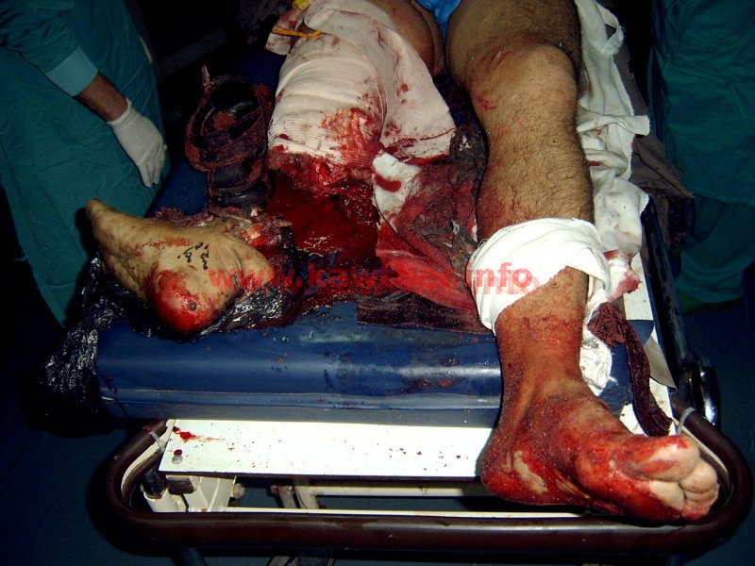
CONTROLLING BLEEDING COMPLETE AMPUTATION

Slide 17
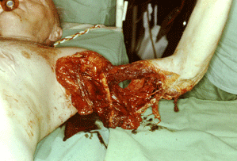
CONTROLLING BLEEDING PARTIAL AMPUTATION

Slide 18
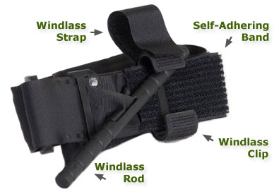
CONTROLLING BLEEDING Combat Application Tourniquet

Slide 19
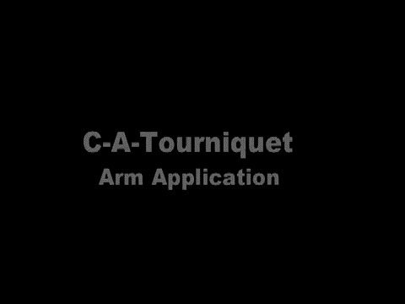
CONTROLLING BLEEDING Combat Application Tourniquet Arm

Slide 20

CONTROLLING BLEEDING Combat Application Tourniquet Leg

Slide 21
CONTROLLING BLEEDING APPLYING AN IMPROVISED TOURNIQUET
Gather materials for making an improvised tourniquet:
Tourniquet band at least 2 inches wide
Rigid windlass / wooden stick
Securing materials
Select tourniquet site
2-4 inches above the wound or joint
Apply the tourniquet

Slide 22
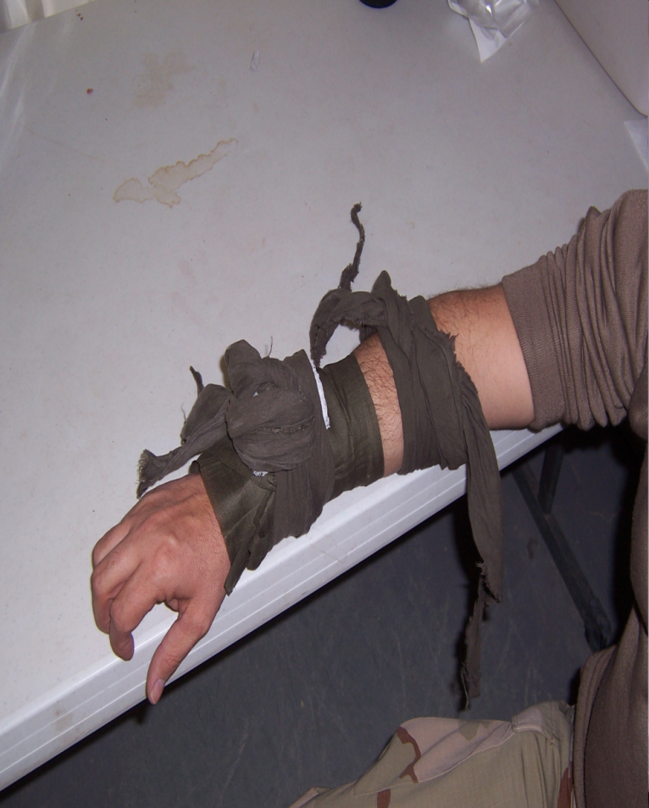
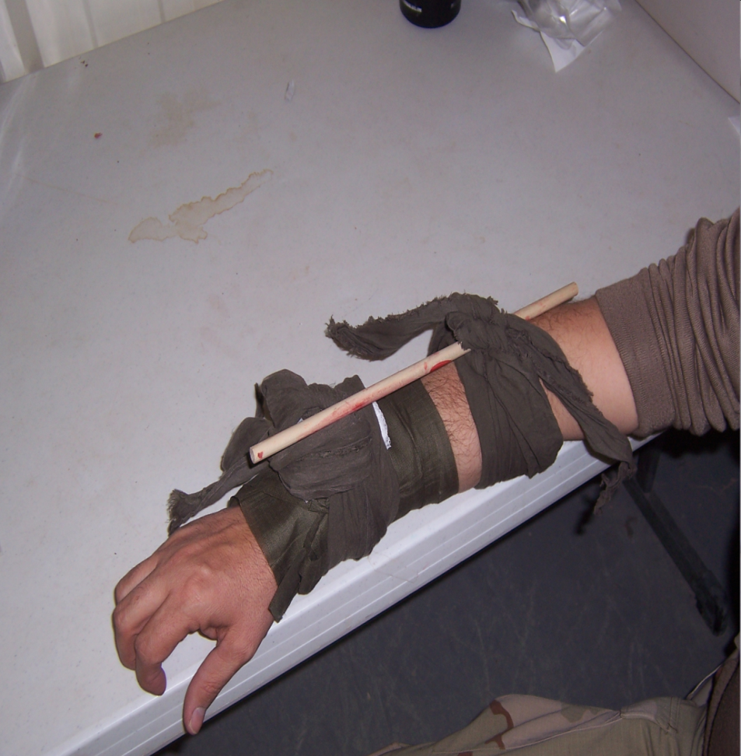
CONTROLLING BLEEDING
HALF KNOT
WOUND
FULL KNOT

Slide 23
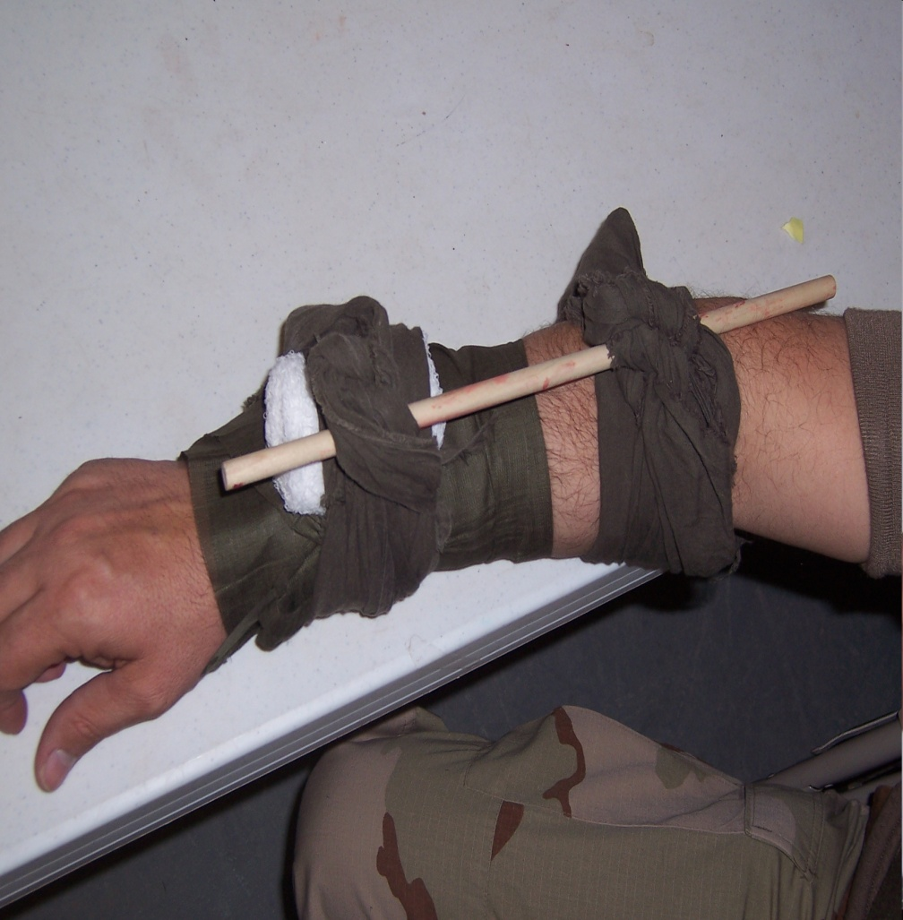
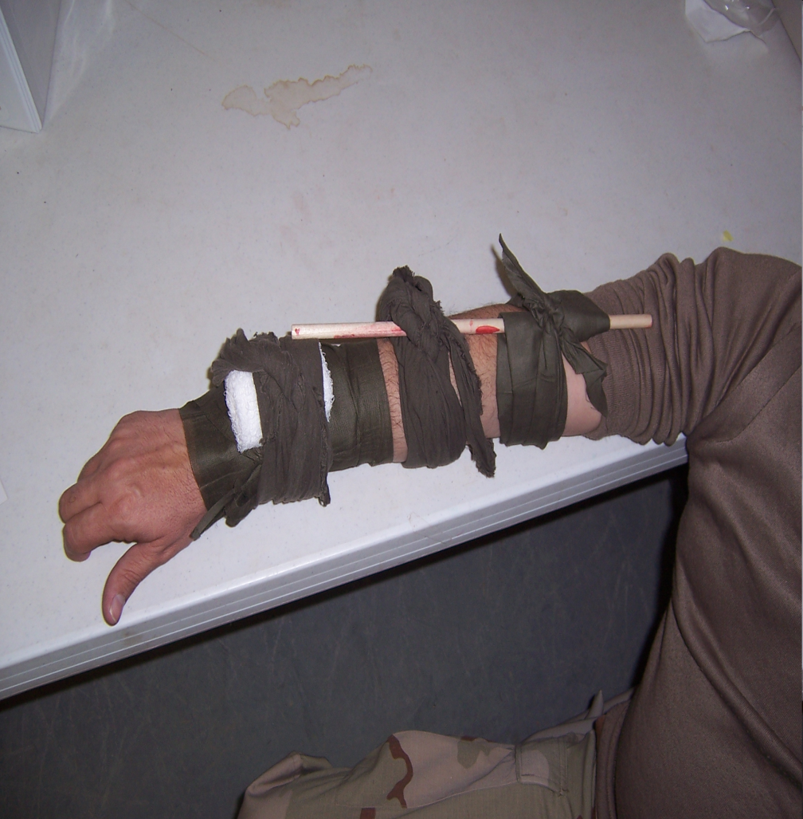
CONTROLLING BLEEDING Securing Tourniquet

Slide 24
CONTROLLING BLEEDING Applying a tourniquet
After applying a tourniquet:
Mark the casualty’s forehead with a “T“ and the time (24hr Format)
Apply a dressing to the partial or full amputation
DO NOT APPLY TQ IF DIGITS ( FINGERS/TOES) ARE AMPUTATED

Slide 25
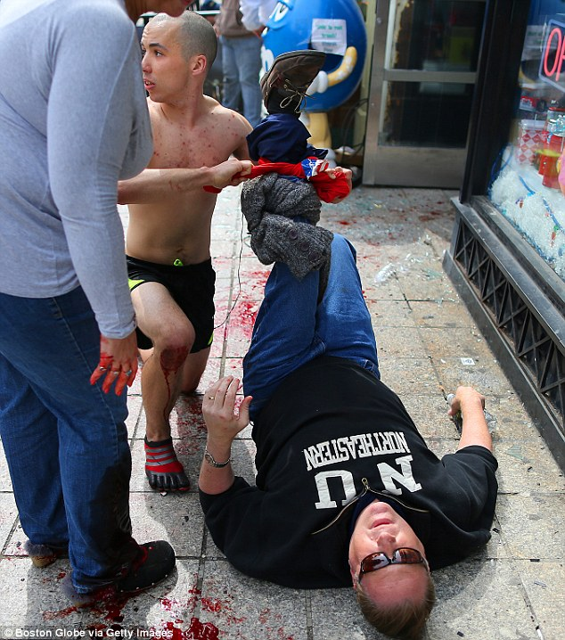
Boston Marathon Bombing
Using belts, shirts and other materials, they [rescuers] tied off bleeding limbs in fast-acting bids to prevent major blood loss, shock and death.
Studies showed timely use of tourniquets could raise survival rates as high as 90 percent. Tourniquets are now routinely issued to soldiers.
The most severe injuries in the Boston bombing resemble those suffered by troops in Iraq and Afghanistan whose limbs were blown apart by improvised explosive devices, and the initial treatment was also identical: First responders, and in some instances, spectators — used tourniquets to cut off the blood flow and stop severe bleeding.

Slide 26
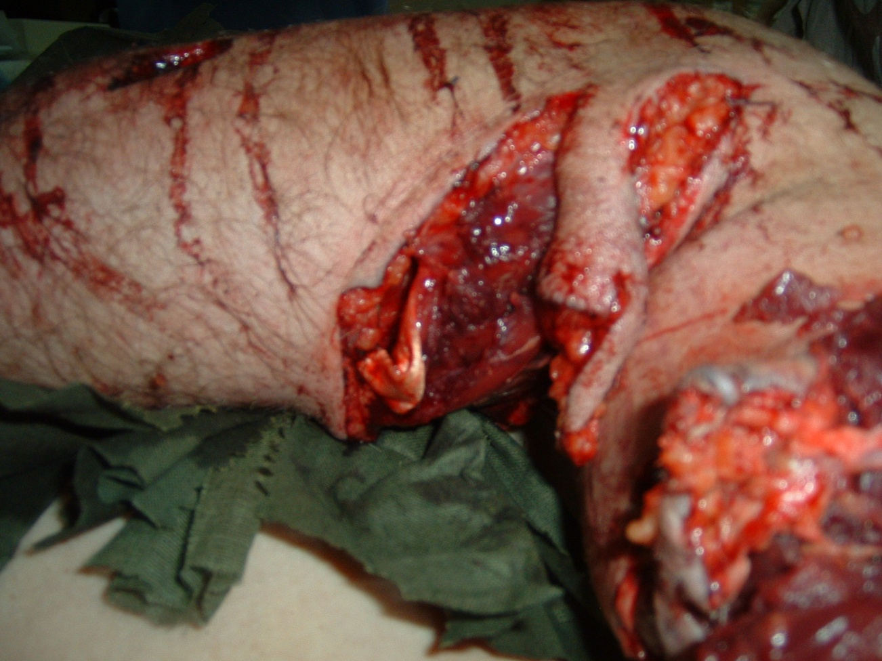
How would you treat this?

Slide 27
QUESTIONS?

